Slide 1
Global Suicide Rates A glimpse at geographic, global and Demographic trends
Data Analytics Bootcamp (T/Th Session)
Nireesha Abbineni
Allyssa Calhoun
Mrinmayee Kulkarni

Slide 2
Our process
We wanted to dive into an issue that had global significance. One that warranted a deeper look into trends, demographics, geographic analysis, and possible correlations
We were able to find the data we needed on Kaggle.com
https://www.kaggle.com/russellyates88/suicide-rates-overview-1985-to-2016
The dataset was compiled from four datasets:
United Nations Development Program. (2018). Human development index (HDI). Retrieved from http://hdr.undp.org/en/indicators/137506
World Bank. (2018). World development indicators: GDP (current US$) by country:1985 to 2016. Retrieved from http://databank.worldbank.org/data/source/world-development-indicators#
[Szamil]. (2017). Suicide in the Twenty-First Century [dataset]. Retrieved from https://www.kaggle.com/szamil/suicide-in-the-twenty-first-century/notebook
World Health Organization. (2018). Suicide prevention. Retrieved from http://www.who.int/mental_health/suicide-prevention/en/
The data was very comprehensive, however we did find a glitch in missing statistics for Baby Boomers in 2010.
Found data grouped with Gen X for that year
We reported the flaw in the dataset to the Kaggle dataset/study page
We also utilized Google API to form a global heatmap(chloropleth) to derive the country coordinates for adding map layers.

Slide 3
Clean UP PRocess
Staged a cleaner version of source dataset upfront with the following cleansing measures:
Standardized the column names. Few attributes have column names with leading spaces which makes it unfriendly for programming.
Removed the duplicate records.
Extracted a 10 year subset from the raw dataset for baselining.
Augmented the dataframe with additional computed columns
Totals by year
Totals by country

Slide 4
Global Assessment

Slide 5
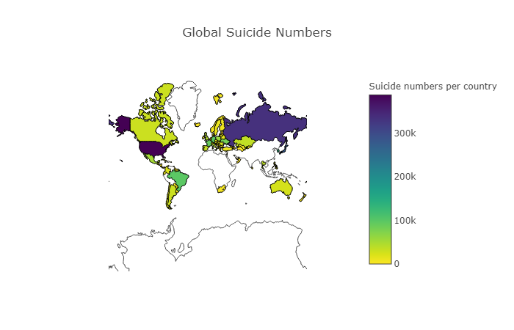
A global issue
Notes:
Insert a map of your country.

Slide 6
Top 3 Global findings from heat map
By utilizing a combination of the Kaggle database and Google API, we were able to create this heatmap which details the number of suicides by country over the ten years analyzed
The gradient scale depicts the areas with the greatest number
A look at global suicides over the last 10 years reveals the issue affects people everywhere.
Our data captured 6,748,420 total suicides
That is a global rate of 13 per 100,000
Russia, alone accounted for 334,082 suicides in the decade we analyzed, an astounding rate of 24.75 of 100,000
Notes:
Insert a picture of one of the geographic features of your country.

Slide 7
Top 10 Countries

Slide 8
A deep dive into the top ten countries
Countries with the highest number of suicides
United States
Russian
Japan
South Korea
Germany
Brazil
France
Ukraine
Poland
Mexico

Slide 9
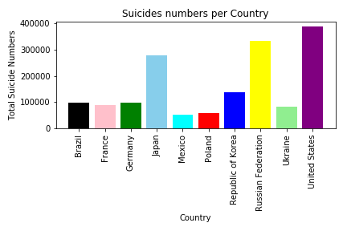
Countries with greatest number of suicides
Most of the top 10 countries are also among the most populous, however, a few smaller countries have a surprisingly high number
There are 2 pockets in Northeast Asia (Korea and Japan) and Eastern Europe (Russian, Ukraine and Poland)
China and India are not included in the dataset
Although the United States has the highest total number, the US rate is the same as the global rate
Notes:
Insert a picture illustrating a season in your country.

Slide 10
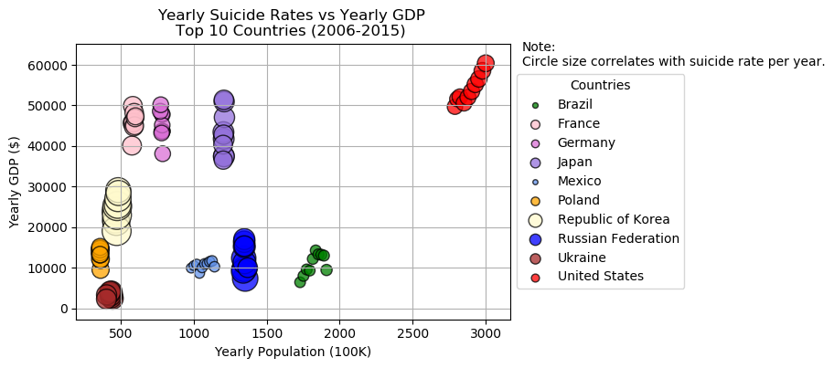
Correlation between GDP and Suicide Rates
We attempted to determine a statistically reliable correlation between GDP and Suicide Rates
Hypothesis was that richer the country, greater the rate
Fact: Hypothesis true? – Not True
Consistent Bubble sizes for most countries indicate there are no noticeable suicide rate hikes even if GDP increased from year to year
Korea and Russia show a slight correlation
The current dataset may not be sufficient for a deeper analysis to provide more insights into the correlation of these dimensions
Notes:
Insert a picture of an animal and or plant found in your country.

Slide 11
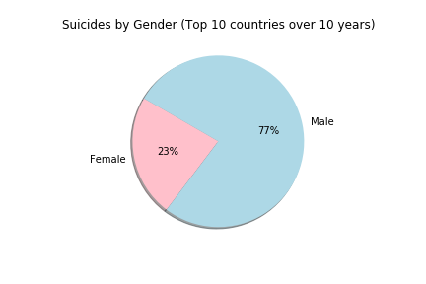
A look at gender disparity—(top 10)
We were surprised how much more prevalent suicide was among males
Males accounted for 77% of all
suicides
This provides a good baseline for a deeper look at individual countries to see if this is a global norm.
Notes:
Add key points in the history of your country to the timeline.

Slide 12
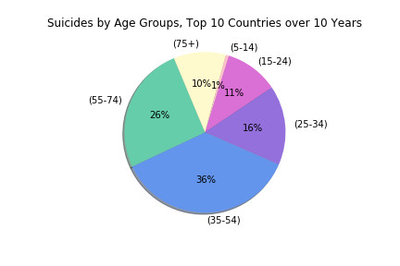
Are certain age groups more susceptible to suicide than others?
The 35-54 age group accounts for the largest segment to succumb to suicide
Perhaps because this is the age where we feel the strongest pressures financially, career-wise, and maritally
At first glance, the 75+ group, comprising 10% of all suicides was surprising
A cursory look at other research suggest a terminal health diagnosis link to be primary cause among this age group
The saddest finding was the 10K children in the (5-14) bracket
Notes:
Insert a picture illustrating a custom or tradition here.

Slide 13
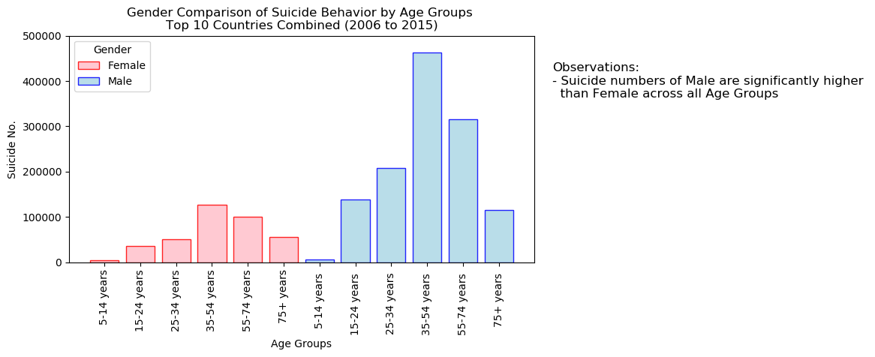
GENDER Comparison across age groups
A histogram of male and female suicide counts across the 6 age buckets show significantly higher numbers among the male compared to female.
The disparity between 35-54 age group male and female suicide rates is much higher than other buckets.
Notes:
Insert a picture of the head leader of your country.

Slide 14
United States

Slide 15
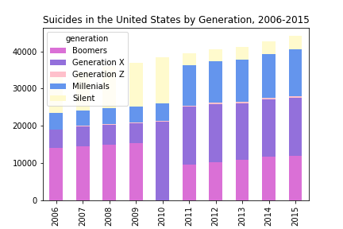
Suicides in the US by Generation
Gen Xers warrant a deeper dive into life stressors and mental issues in that generation
Part of the increase can be explained by them moving into the most dangerous age group for suicides, (35-54)
Numbers are especially alarming when this generations has 15 year birthyear span vs. some of the others (up to 21years)
The data appears to follow 2 separate trend lines. One from 2006-2010 and the other from 2011-2015
Perhaps separate original source datasets were used to compile original dataset
Notes:
Insert a picture that illustrates some part of your country’s economy.

Slide 16
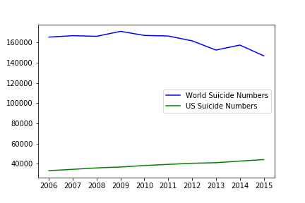
Trend Comparison US VS. Global
Suicides are a global issue but there are significant differences in country rates
An unfortunate trend is that the US suicide numbers are growing while the combined global numbers are declining

Slide 17
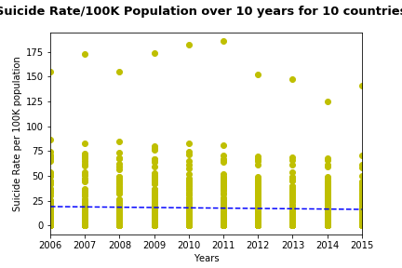
Statistical Analysis
Linear regression line for data of 10 countries over 10 years takes a little dip from 2010 to 2015.
But the overall rate is very much stagnant.
The median for suicide rate over-all is 732 and 10 per 100K population.
This difference in over-all and per 100K rate tells us the huge gap between the countries with higher rates than others.
Notes:
Insert a picture of one of the points of interest for your country.

Slide 18
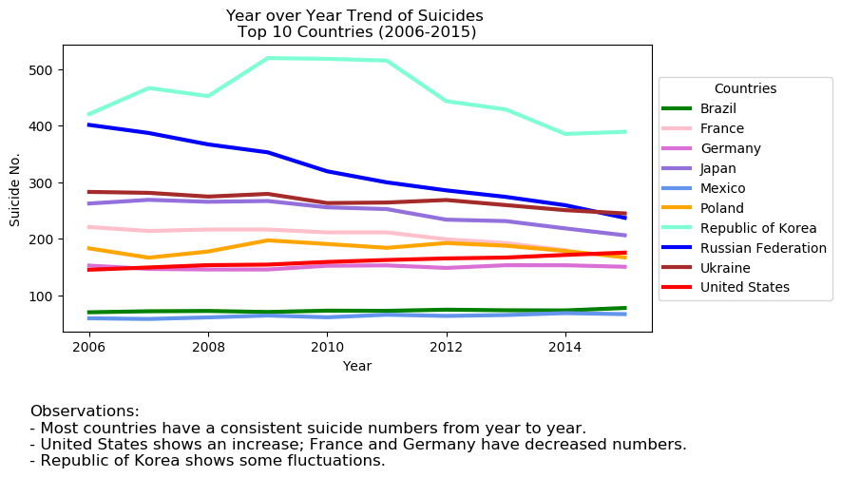
Conclusions: Identifying hot spots
What are the countries with higher suicide rates?
We found the top 10 countries with higher suicide rates and their trends from 2006 - 2015.

Slide 19
Conclusions: Correlations
Is there any impact of GDP on the suicide rates in the top countries?
As observed in the scatter plot, we did not find any significant correlation to GDP
A dataset with more economic factors would be necessary to complete satisfy our hypothesis

Slide 20
Conclusions: Correlations
Are there any generational trends, age or gender factors that can be identified?
Gen Xers popped as having a higher suicide rate than other generations
Males have significantly higher suicide numbers than females
The 35-54 age group accounts for the largest segment to succumb to suicide

Slide 21
Conclusions: Data Analytics Learnings
Dataset limitations found:
India and China were not included in dataset
Because of their populations, this left a meaning gap in information
2010 was missing information for Baby Boomers in the US
2006-2010 and 2010-2015 showed two very different trend lines which may indicate a change in statistical methodology for the original dataset
Data Analytics Learnings
Your analyses are only as good your data!
It is hard to stay within scope when you have such a wealth of information at your fingertips
With the right tools, you can tame any amount of information and glean useful insights

